Slide 1


CULTIVE
A MINI PROJECT BY:
Shashank -18H51A05H3
Goutham Rathod -18H51A05H4
Sharni Reddy Arjula-18H51A05H5
PROJECT GUIDE:
Dr. P Chandra Shaker Reddy
DEPARTMENT OF COMPUTER SCIENCE & ENGINEERING
CMR COLLEGE OF ENGINEERING & TECHNOLOGY
Kandlakoya(v) , Medchal(D)-501401

Slide 2


Table of Contents
Abstract
Objective
Block diagram
Existing Solutions
Requirements
Features
Principle of Operation
Result
Market Analysis
Future Scope
Conclusion

Slide 3
ABSTRACT
During the global pandemic, lockdown restrictions took effect, and panic buying cleared supermarket shelves, home gardening experienced a well-publicized boom. We all realized that these days’ fruits, veggies are doing more harm than good because of the chemicals being used. Pandemic made us learn the importance of a healthy lifestyle and the demand for small space gardening, rooftop gardening has increased tremendously. But not everyone is an expert in growing plants. Plants need proper nutrition as well. Our project idea is called Cultive – Learn and Buy Plants Online, A one-stop destination for gardening. The main aim of our project is to provide a platform where the user can gain knowledge about plants, also can buy plants, gardening equipment, and many more. The slogan behind the idea is to make people realize gardening is not as hard as it seems if it is done in the right way with proper guidance.

Slide 4
OBJECTIVE
Gardening requires knowledge about how to treat and grow different plants, treat diseases, etc. Though, there are many websites available on the internet where the user can gain knowledge and buy plants. However, there is no specific website available, that is completely dedicated to gardening enthusiasts to learn about plants, buy different plant products, attend workshops to gain knowledge, etc. Overall, The main aim is to provide a one-stop destination for gardening.

Slide 5
EXISTING SOLUTIONS
Amazon and Flipkart are some of the E-Commerce sites which provide plant seeds, fertilizers, Pots and pesticides but they do not provide the information regarding how to grow and maintain the plants according to it’s particular season.
DRAWBACKS
Too many websites provide different information which sometimes may be misleading.
E-commerce sites do sell products related to plants but do not provide any information regarding the use. For example: Amazon do sell plants seeds but doesn’t tell how to take care of those plants, fertilizers that are required for specific plant.

Slide 6
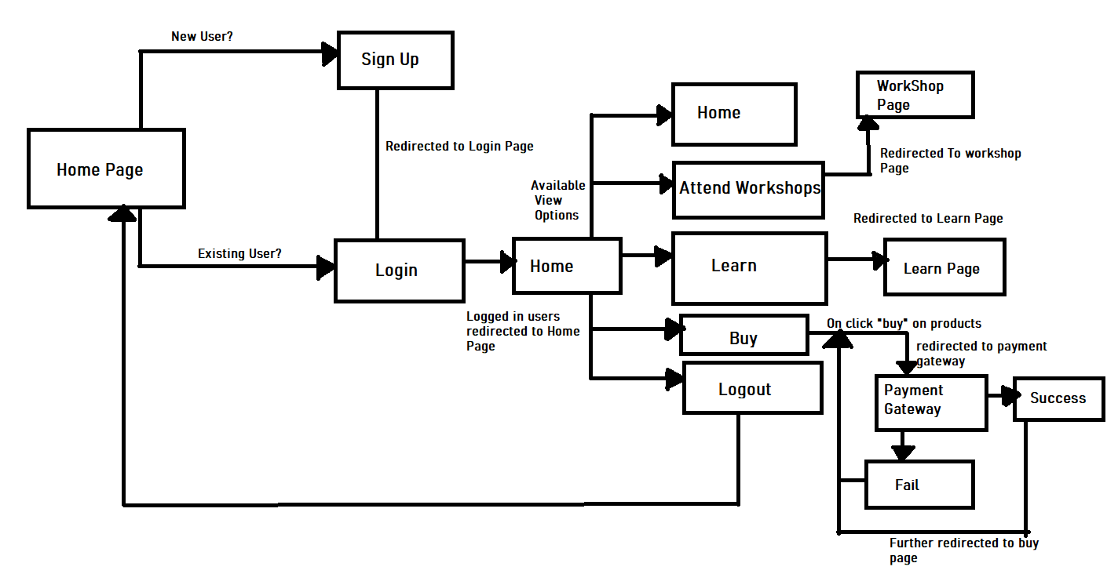
BLOCK DIAGRAM

Slide 7
REQUIREMENTS
Software Requirements:
HTML
CSS
BOOTSTRAP
NODEJS
EXPRESS JS
MONGO DB
RAZOR PAY

Slide 8
FEATURES
WORKSHOPS
RESPONSIVE
LEARN
EASY TO USE
BUY

Slide 9
PRINCIPLE OF OPERATION
If user is a new user, then user can register through signup button provided in the home page or else can login through login button.
Home page displays all the information about the website and the features about the website.
Learn Page consists of number of articles that user can access from and gain knowledge about gardening
Workshop page displays the upcoming workshops and also details like what the workshop is about and all.
Buy Page consists of number of products ranging from gardening equipments to plants seeds. The Payment gateway used is razor pay.
As soon as the user logins the Logout and the user name is displayed on the Home page. The user can logout from the page using logout button.

Slide 10
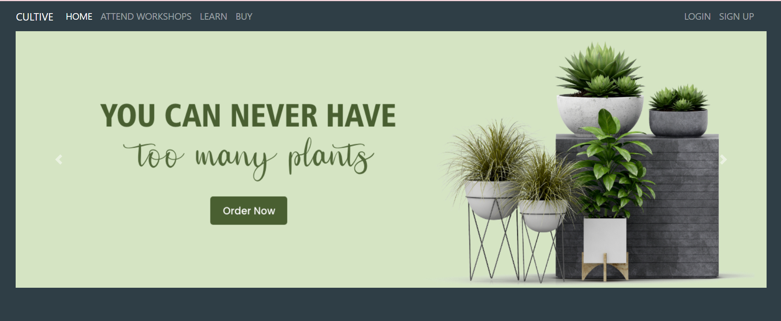
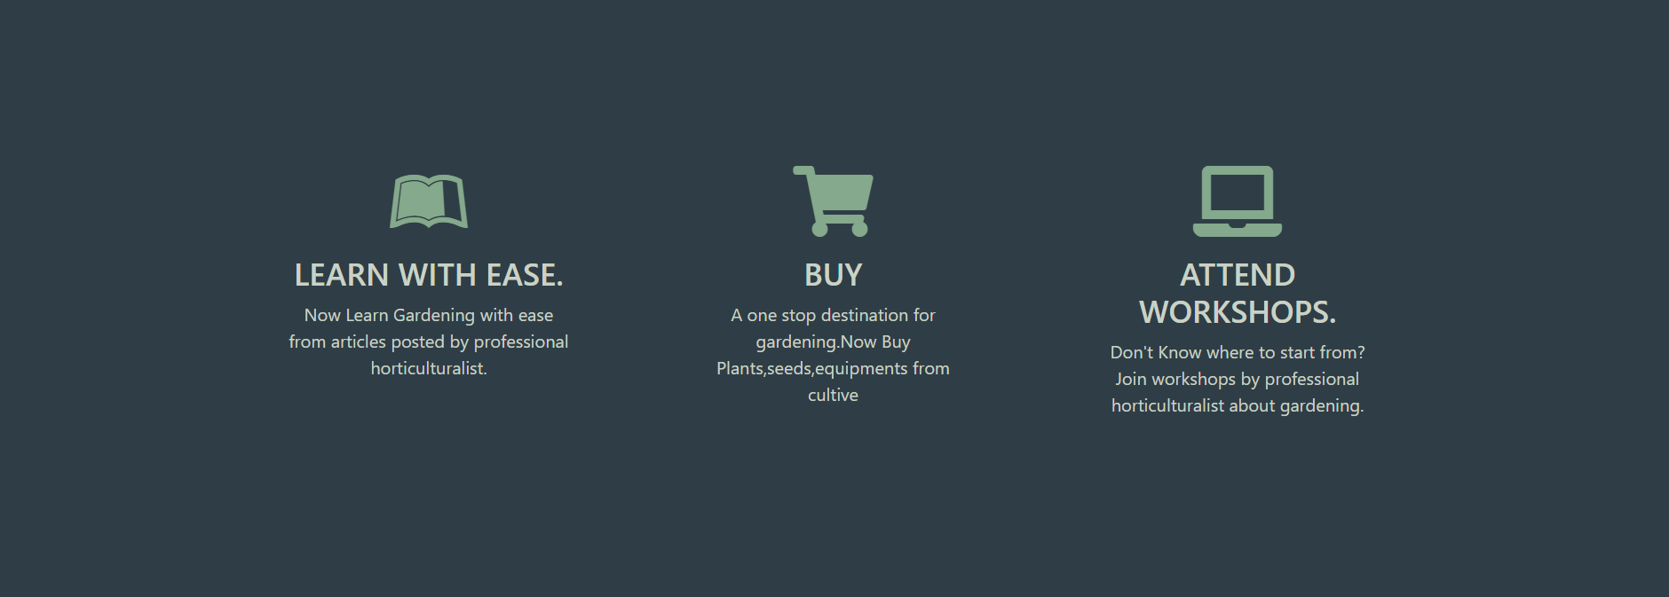
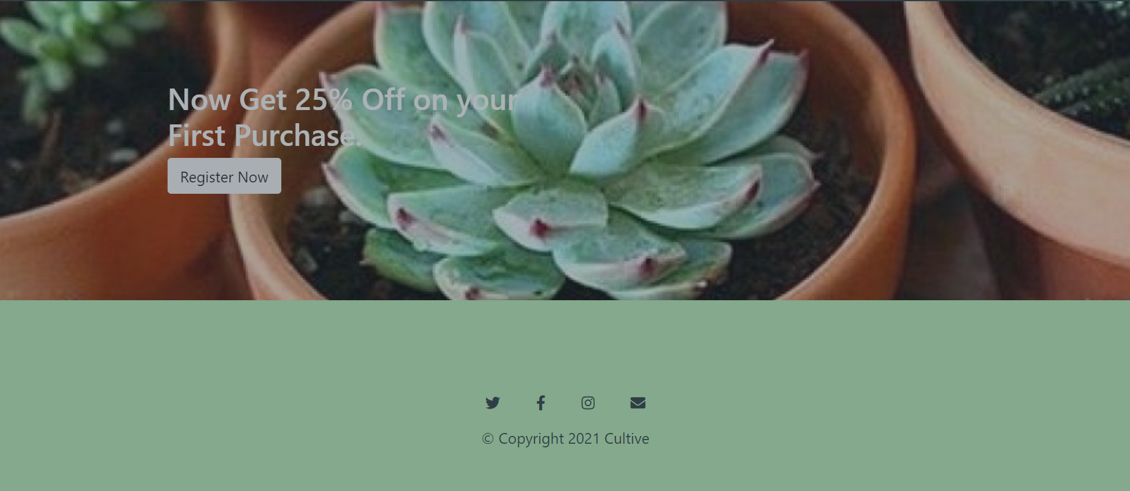
RESULT
:
New User can Register through “SIGNUP”. Existing user can sign in through “LOGIN”
Features that are available for the user.

Slide 11
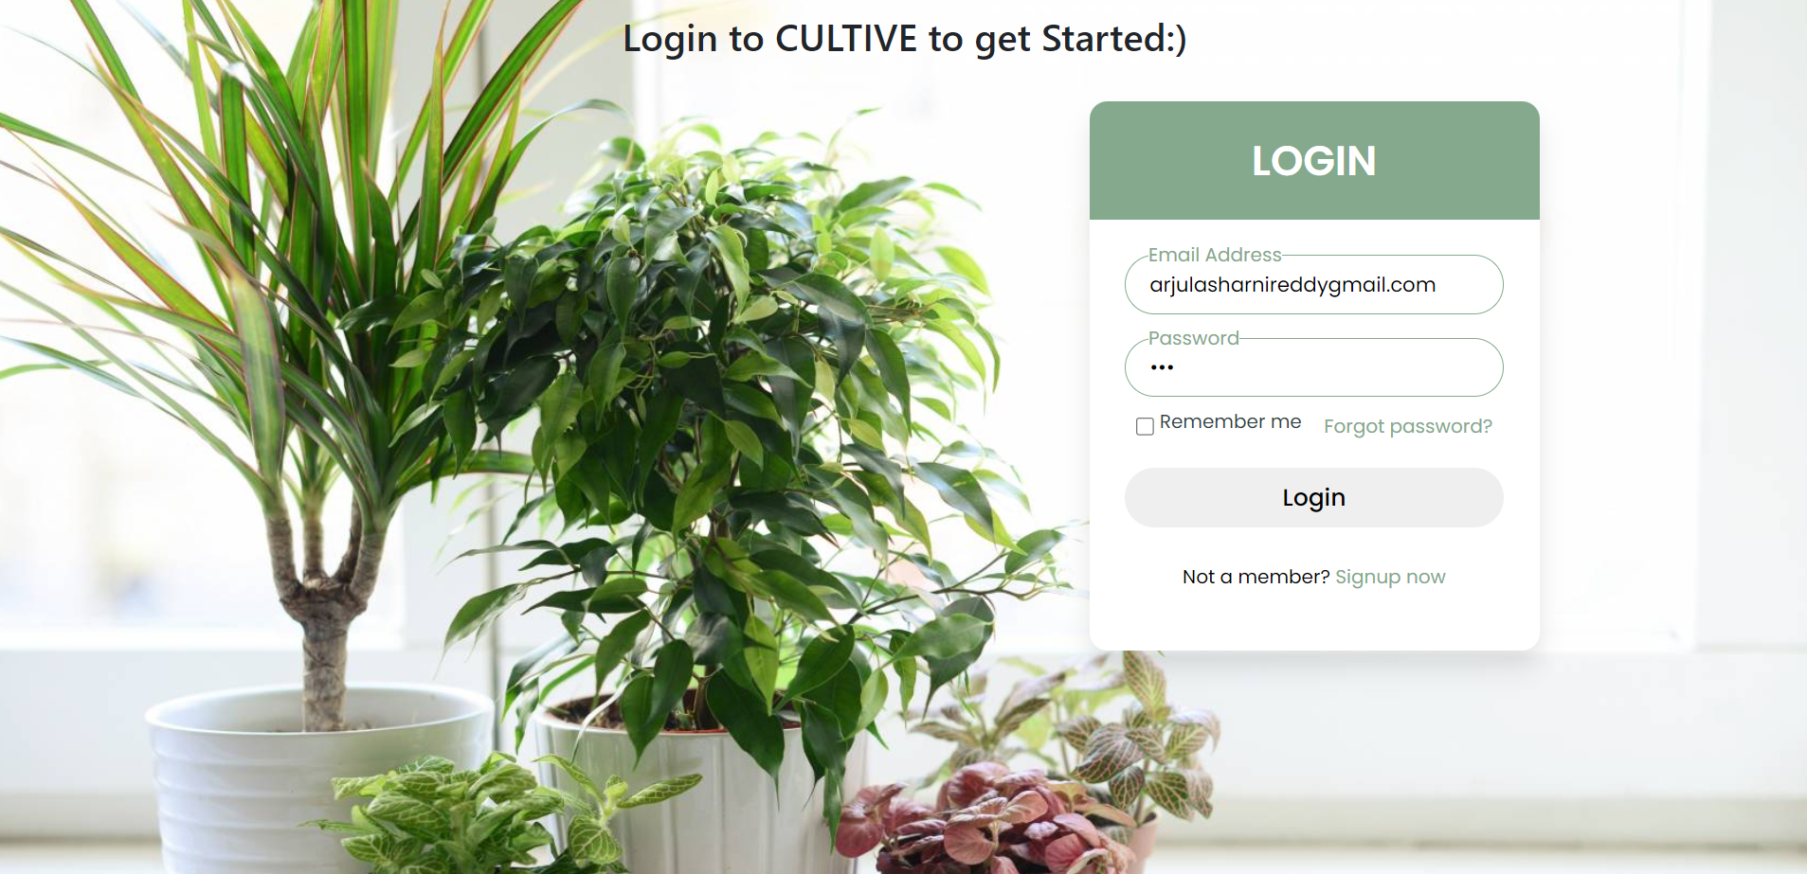
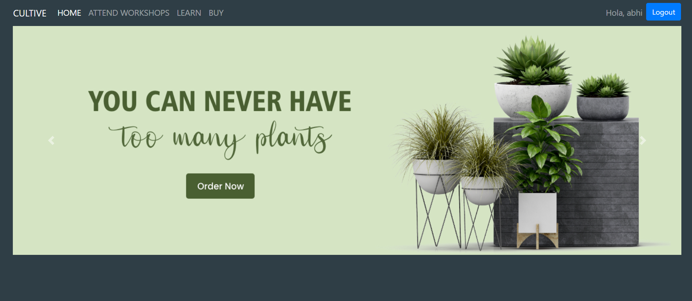
RESULT
:
Once the user is logged
in Username
Displayed
On home screen.
Logout displayed on
Home screen.
Enter user credentials

Slide 12
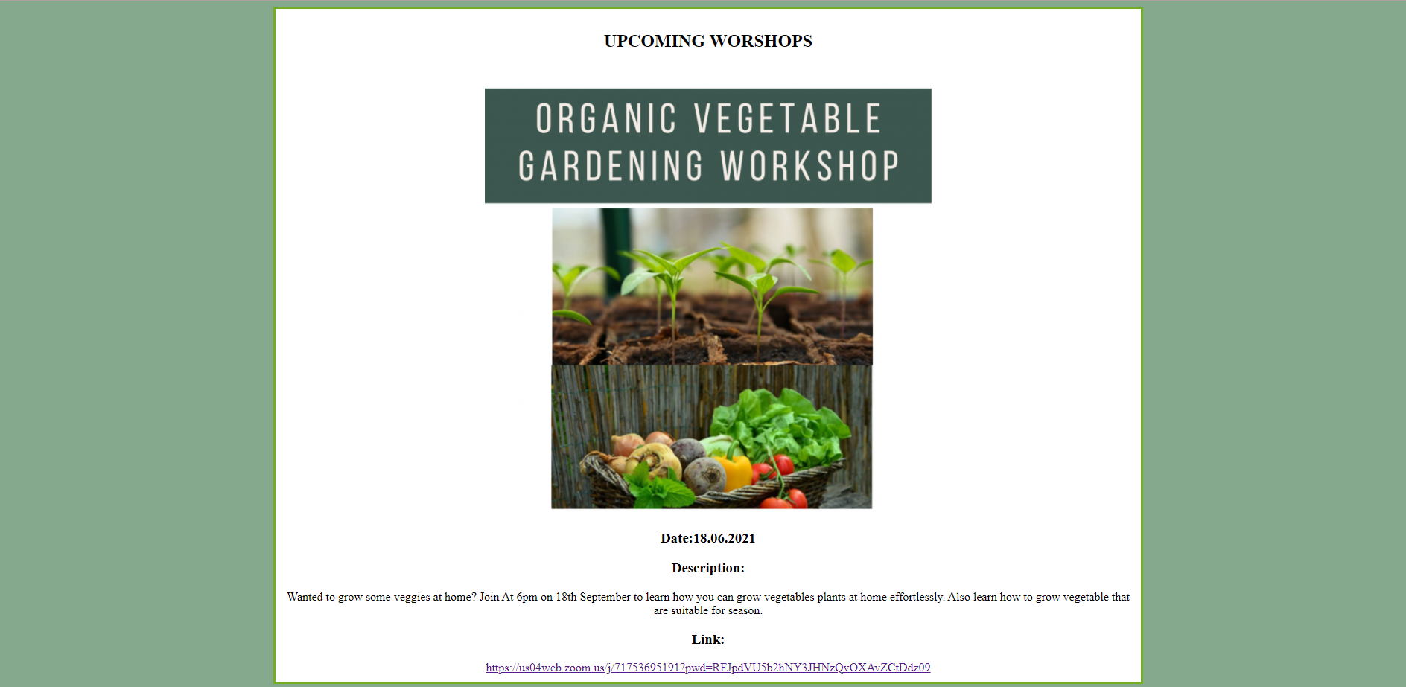
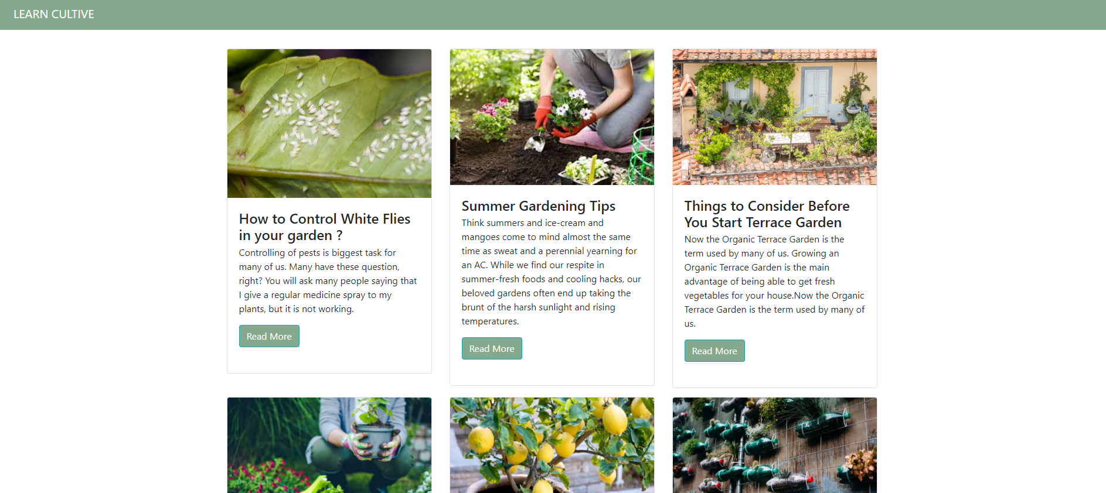
RESULT
:
On clicking Learn the page is redirected to learn page. This page consists multiple articles that can be accessed through “READ MORE”
On clicking Attend Workshops the page is redirected to workshop page. The link is redirected to zoom

Slide 13
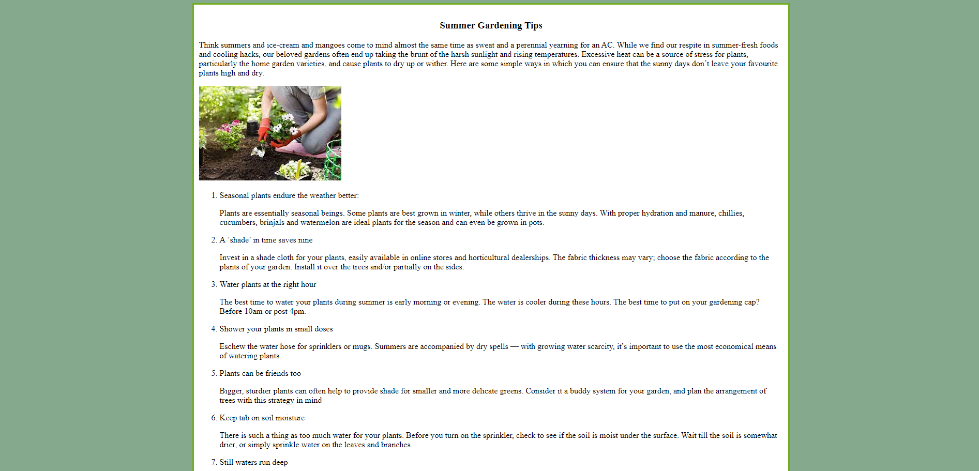
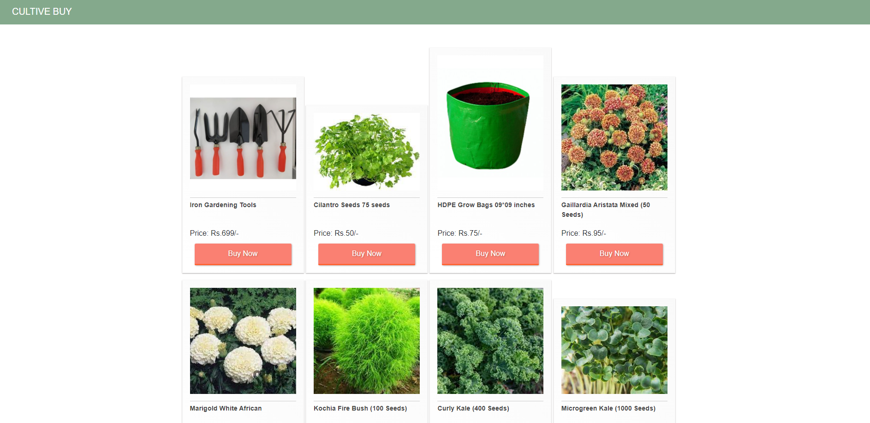
RESULT
:
Articles that can be accessed from Cultive Learn
Products that can be purchased from cultive buy.

Slide 14
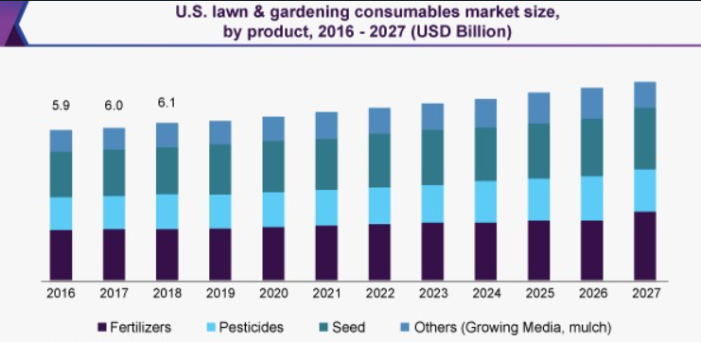
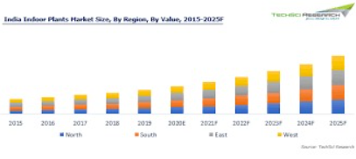
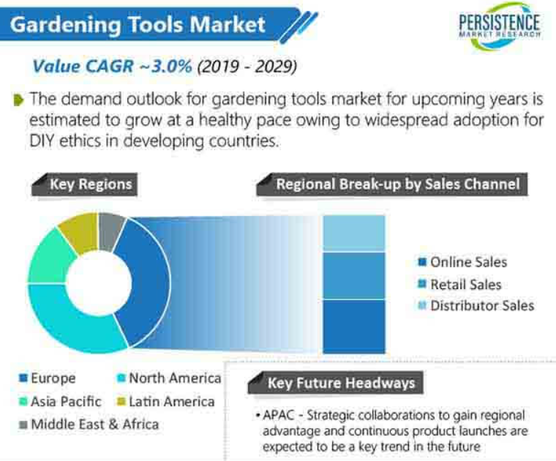
MARKET ANALYSIS
The target market could be any individual who is into home gardening. The growth of gardening industry has been increasing rapidly. Approximately 20% of the population age 18-34 reports gardening as a leisure pursuit. The gardening industry saw an incredibly healthy spike in revenue, despite COVID-19. The sales revenue for the building material and garden retail sector actually increased by 8.6% between Spring 2019 and Spring 2020. The global gardening equipment market size was valued at USD 74.1 billion in 2015 and is expected to witness significant growth owing to its growing adoption in the residential and commercial construction industries.

Slide 15
FUTURE SCOPE
To Provide survey forms that will help the user to analyse the disease of the plant and treat them.
:
To provide remainders for upcoming events and workshops that the user has registered.
To add a booklist where user can save favourite articles from learn page and can easily access from booklist.
To provide booking appointments feature for users to book appointments with horticulturalists to seek guidance.

Slide 16
CONCLUSION
Cultive is just a one stop destination for the gardening enthusiasts where the user can learn, buy, attend workshops and engage themselves with likeminded people who are having passion for gardening, etc. Out of many information that is available on the internet that may be misleading, user can learn and seek guidance from professional horticulturalists.

Slide 17
THANK
YOU

